Slide 1
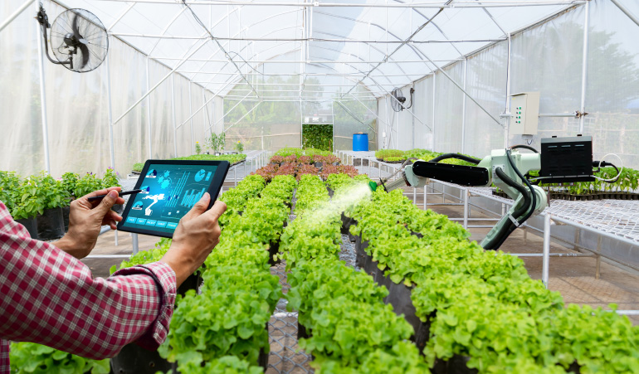
Automated Greenhouse Monitoring System
Prepared by: Bits Wizards Team

Slide 2



Our Team
Mostafa Edress
Samar Ibrahim
Fathy Anas

Slide 3



Download

Slide 4




Table Of Content
Overview
System Architecture
Project Layers
Result

Slide 5

Project Overview
Maintaining optimal greenhouse conditions is essential for healthy plant growth and maximizing yield. Manual monitoring and adjusting of temperature, humidity, light, and soil moisture can be labor-intensive and error-prone, leading to inconsistent growing conditions. To ensure reliable and efficient greenhouse management, an automated solution is needed to optimize the monitoring and control of these environmental factors.

Slide 6
Project goals
To develop an Automated Greenhouse Monitoring System that ensures optimal growing conditions for plants by automating the monitoring and control of environmental factors such as temperature, humidity, light, and soil moisture.

Slide 7
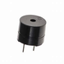
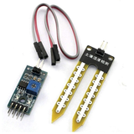
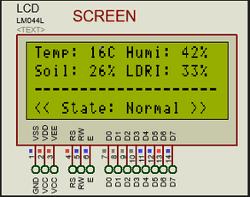
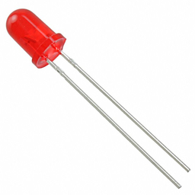
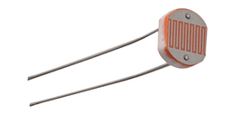
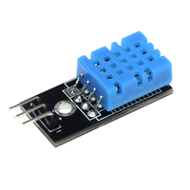
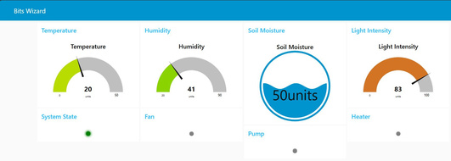
System Architecture
Microcontroller Units (MCUs)
Display Unit
Control Unit
Alert System
Sensor Module
Master MCU:
Reads sensor data.
Controls fan, heater, pump, and LED.
Slave MCU:
Displays data on a 20x4 LCD.
Send data to Node red Server
LCD 20*4
Buzzer
Red led
to generate alerts if values go out of the optimal range.
Soil Moisture Sensor
Fans and Heaters: Manage temperature.
Irrigation System: Controls soil moisture.
Grow Lights: Regulates light intensity.
Light Intensity Sensor
DHT11 Sensor
Node Red Server
Send notification to the user on mobile app

Slide 8
1
Microcontroller Abstraction Layer
Hardware Abstraction Layer
2
Project Layers
Application Layer
3
Library Layer
4
Service Layer
5

Slide 9
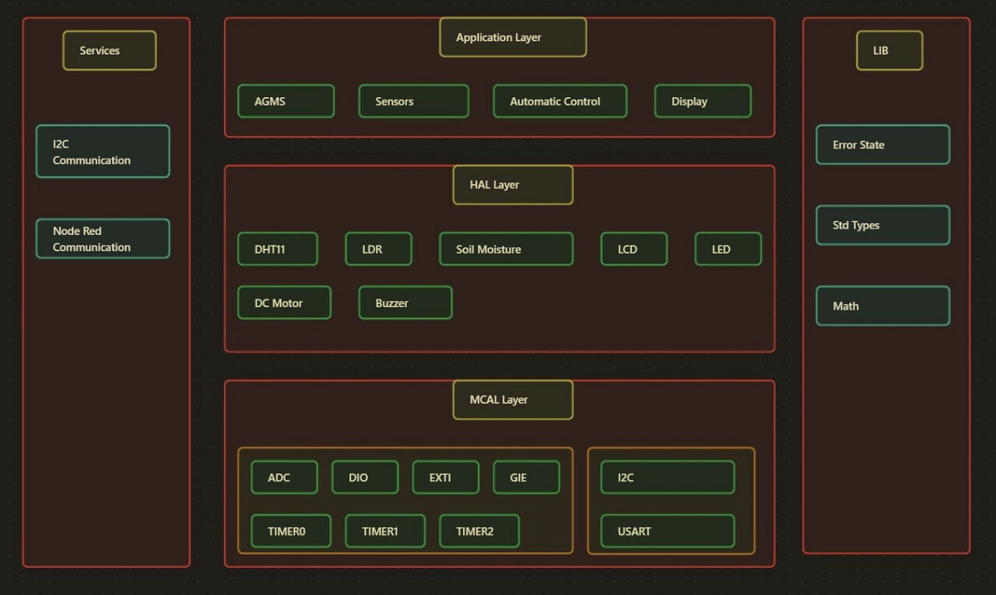

Slide 10


AGMS: Coordinates sensors, automatic control, display units, and communication systems
Application Layer
Automatic Control: Regulates heating, irrigation, and lighting systems.
Display: Manages data visualization on LCD and Node-RED.
Sensors: Integration and management of various sensors

Slide 11
I2C Communication Frame: Manages data transmission with checksum for data validation
Services Layer
Node-RED Communication: Handles data transfer to Node-RED server, provides remote monitoring

Slide 12
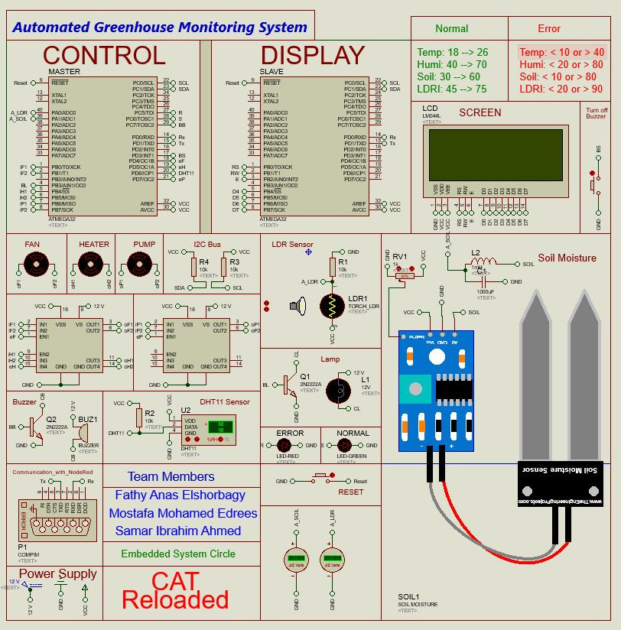
Project Schematic on Proteus

Slide 13

Range of Normal and Error State
Error
Normal
Temperature :<10 or >40
Humidity :<20 or >80
Soil moisture :<10 or >80
Light intensity:<20 or >90
Temperature :18->26
Humidity :40->70
Soil moisture :30->60
Light intensity:45->75

Slide 14

Node Red Dashboard

Slide 15
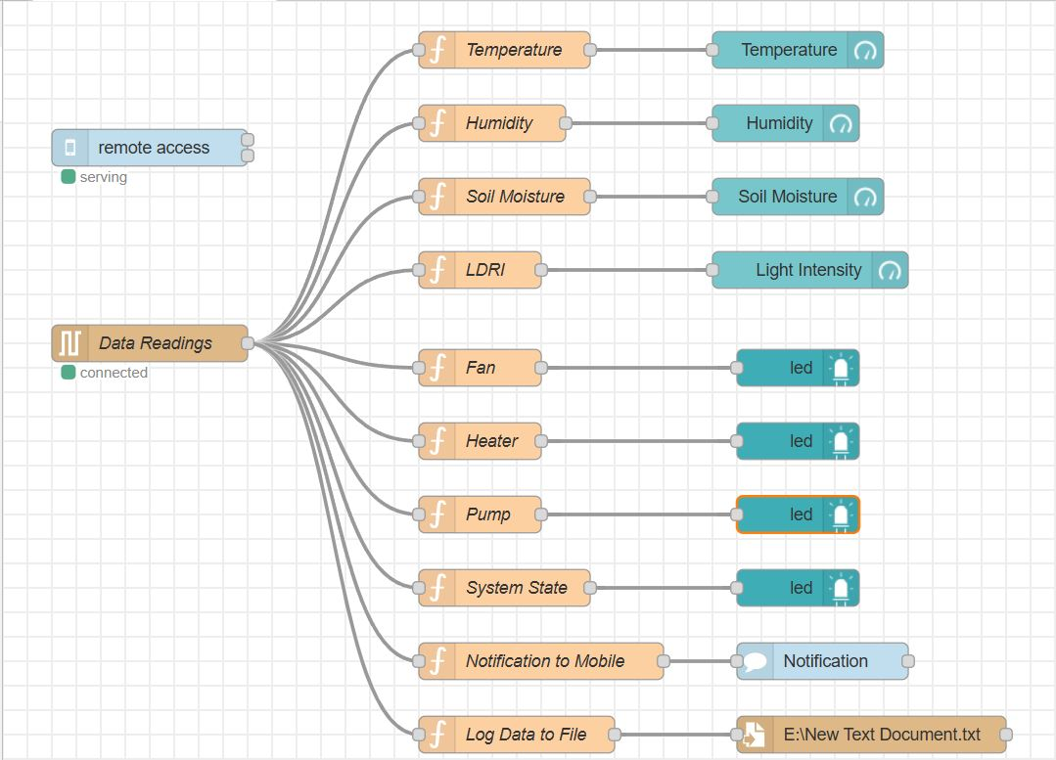
Node Red Dashboard

Slide 16
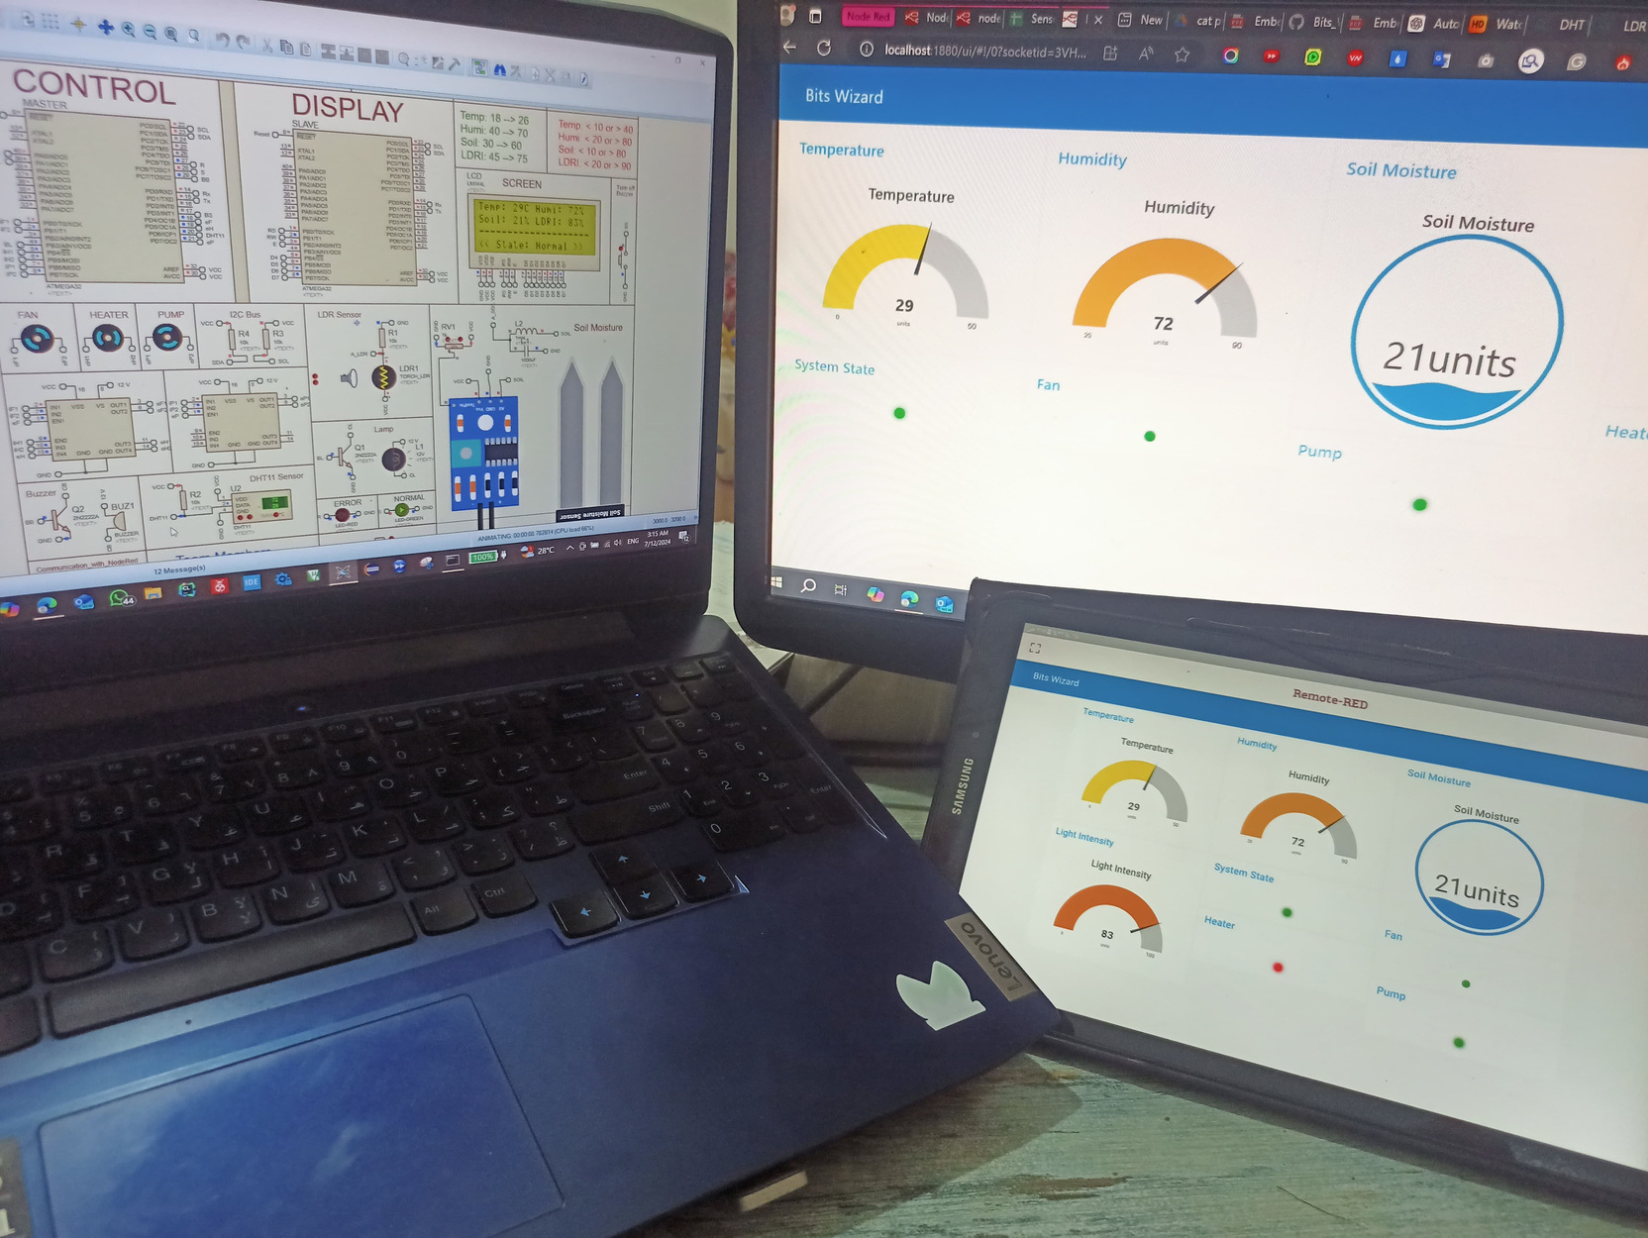
Final Output

Slide 17




Thank
You

